Slide 1

ELECTRONIC VOTING MANAGEMENT
PRESENTED BY:
MUHAMMAD DANIAL NAWAZ
MIUHAMMAD NADEEM
MUHAMMAD MUZAMMIL

Slide 2
EVM
GUI
Password protected
Voter Interface
Admin Interface
Two Interfaces

Slide 3
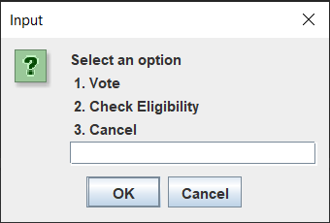
Graphical User Interface
WE HAVE NOT USED THE COMPLETE GRAPHICAL USER INTERFACE BUT JUST ONE CLASS.
We have coded the project with GUI by importing the JAVA Swing Class Joptionpane.
Simple Dialog Boxes appear on the screen one by one displaying various options.

Slide 4
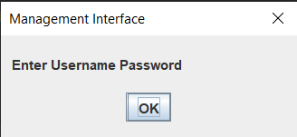
PASSWORD PROTECTED
Username and Passwords are assigned to each user individually

Slide 5
The Project Includes two Interfaces

Slide 6
MANAGEMENT INTERFACE
To add voters
To show results
Add candidates
Eliminate candidates(under development)

Slide 7
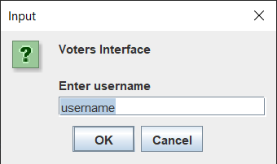
VOTER INTERFACE
Can vote
Can check eligibility
Register to vote

Slide 8
Thank You

